Slide 1
Project Description:Mercado Livre E-commerce Analysis This capstone project presents an end-to-end data analysis of Mercado Livre, a leading Latin American e-commerce platform. Using a combination of SQL, Python, and Power BI, the project provides actionable insights into operational efficiency, customer behavior, payment trends, and logistics performance. The analysis is based on real-world transactional and order-level data extracted from the Mercado Livre platform. The core objective was to uncover business patterns and performance metrics to support strategic decision-making.
Capstone Project
Used SQL for complex queries, joins, and subqueries to extract business insights from large datasets.
Built a machine learning classification model in Python to predict whether an order would be delivered on time or delayed,
based on features like shipping limit date, delivery days, and order item count.
Evaluated the model using metrics like accuracy, precision, and recall,
and interpreted feature importance for actionable recommendations.

Slide 2
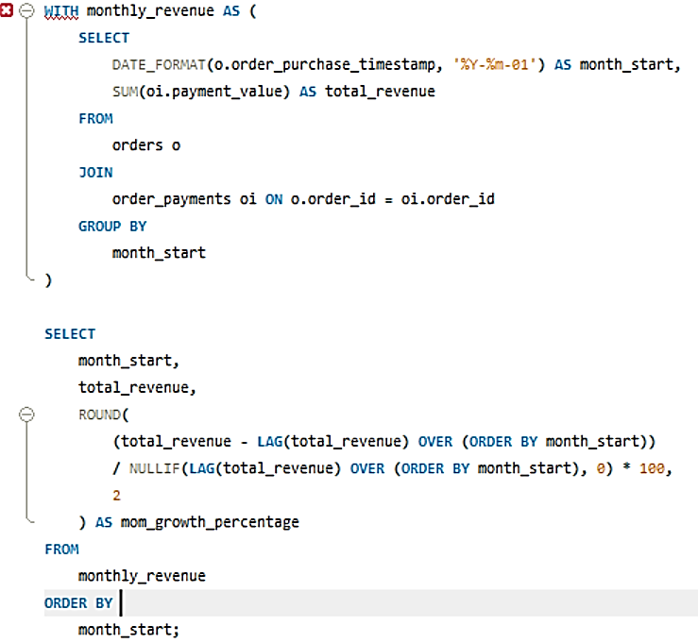
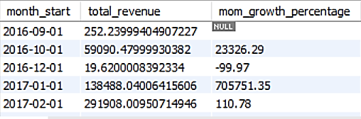
Monthly Revenue Growth Rate: For each month, calculate total revenue and month-over-month growth percentage.

Slide 3
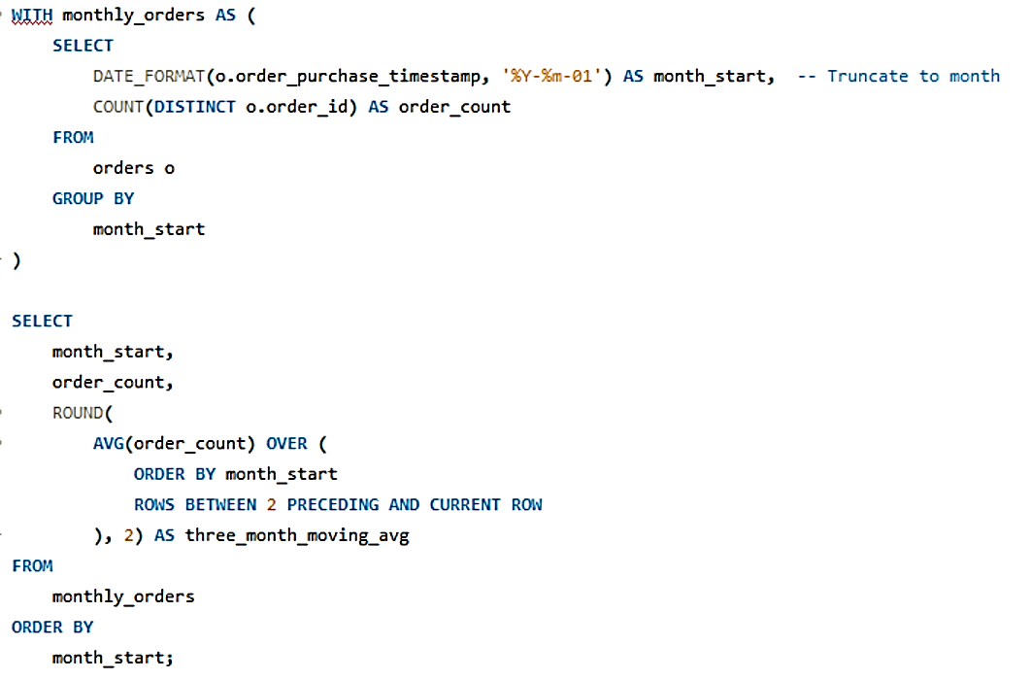
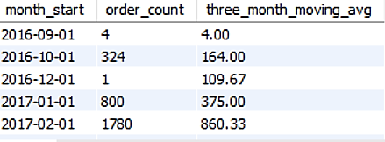

Slide 4
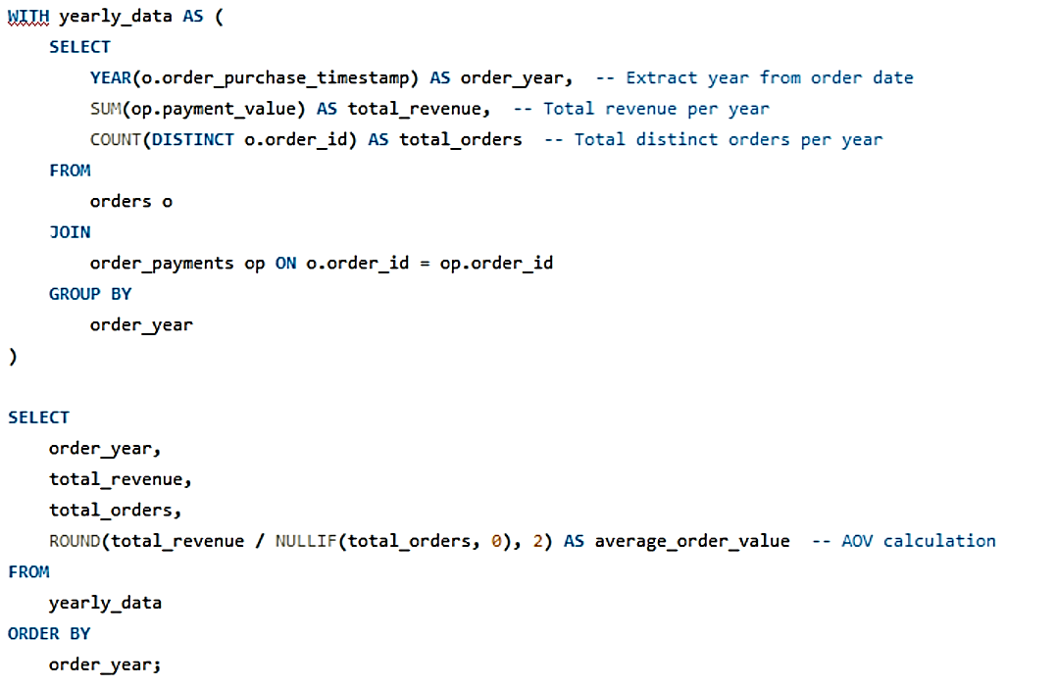
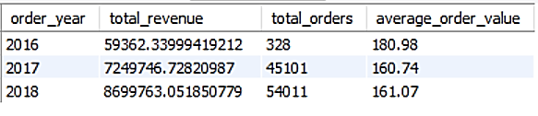
Yearly Average Order Value (AOV): Trend Compute average order value (total revenue / total orders) per year.

Slide 5
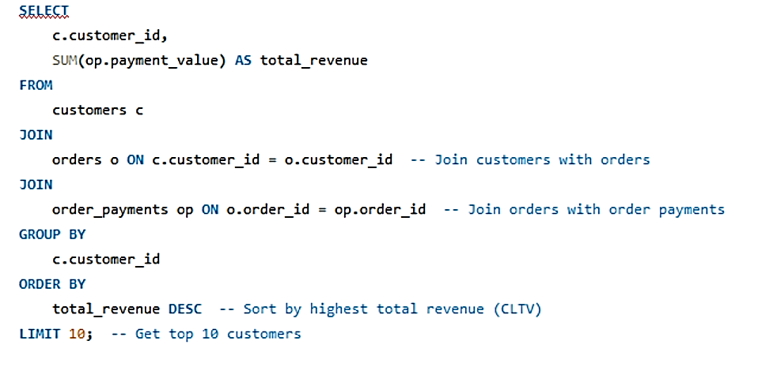
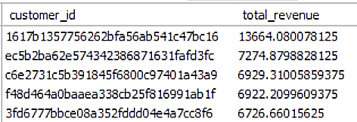
Customer Lifetime Value (CLTV) Approximation: Calculate total revenue generated by each customer. Sort top 10 highest lifetime values.

Slide 6
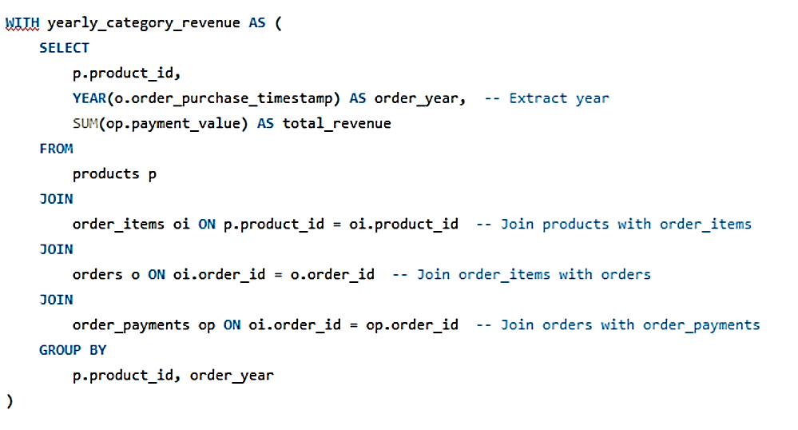
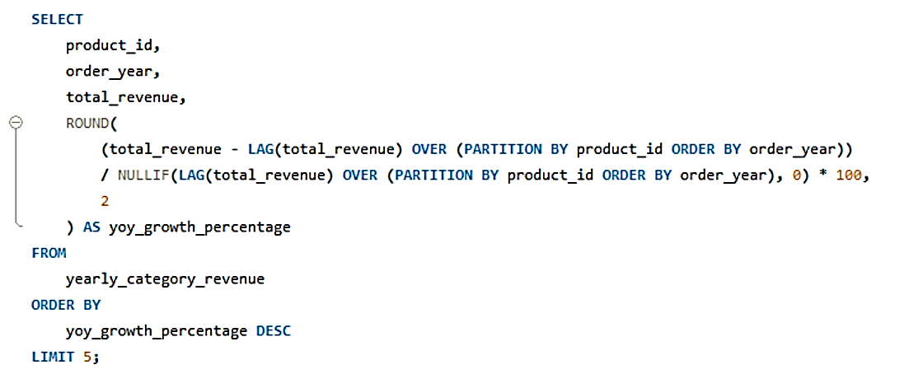
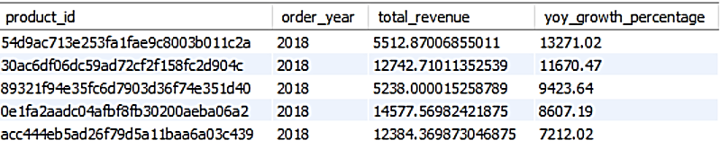
Top Product Categories by Growth: Identify top 5 categories with the highest year-over-year revenue growth.

Slide 7
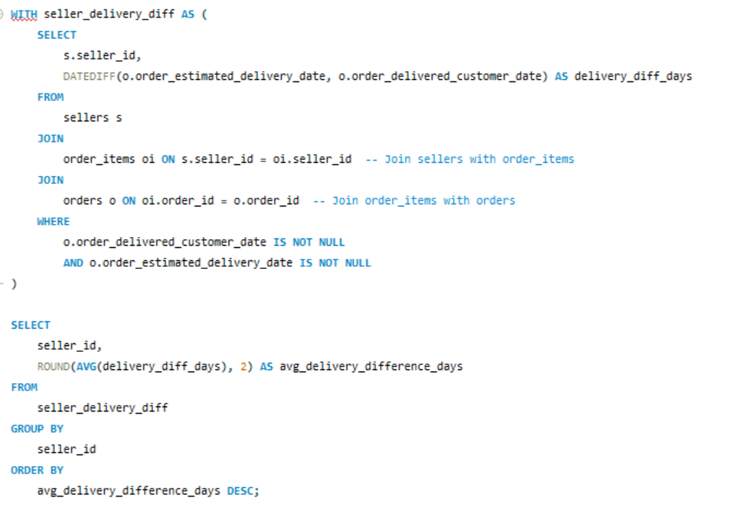
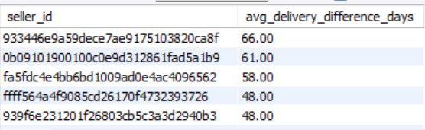
Seller Fulfillment Efficiency: For each seller, calculate the average difference between estimated and actual delivery date. Highlight the most efficient ones

Slide 8
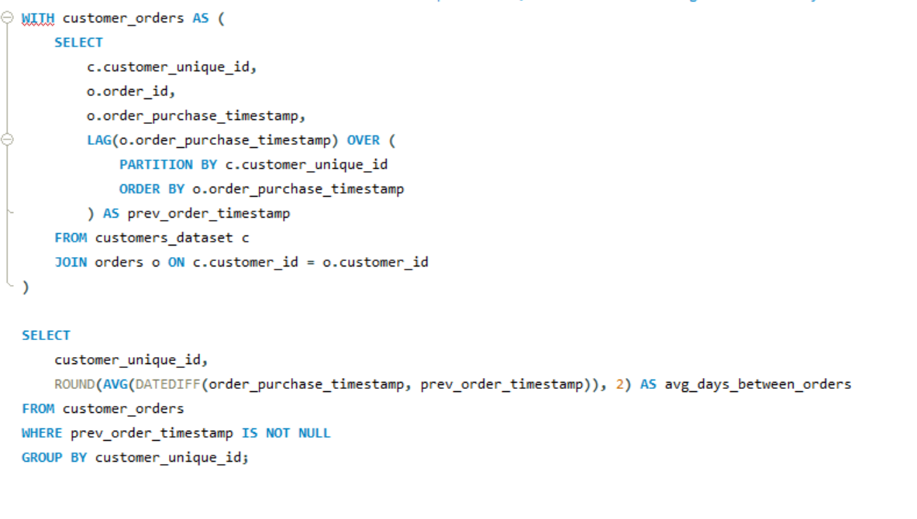
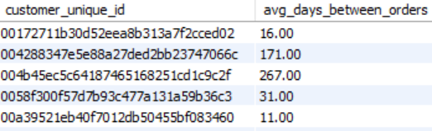
Time to First Purchase: For customers with multiple orders, calculate the average number of days between account creation and first purchase.

Slide 9
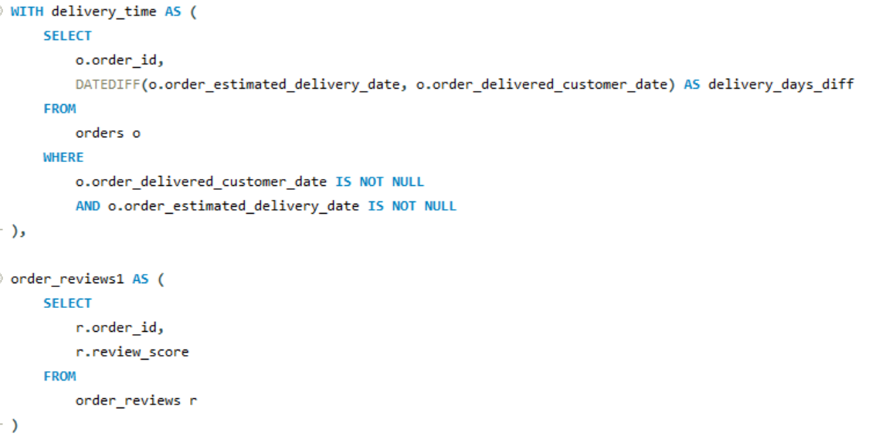
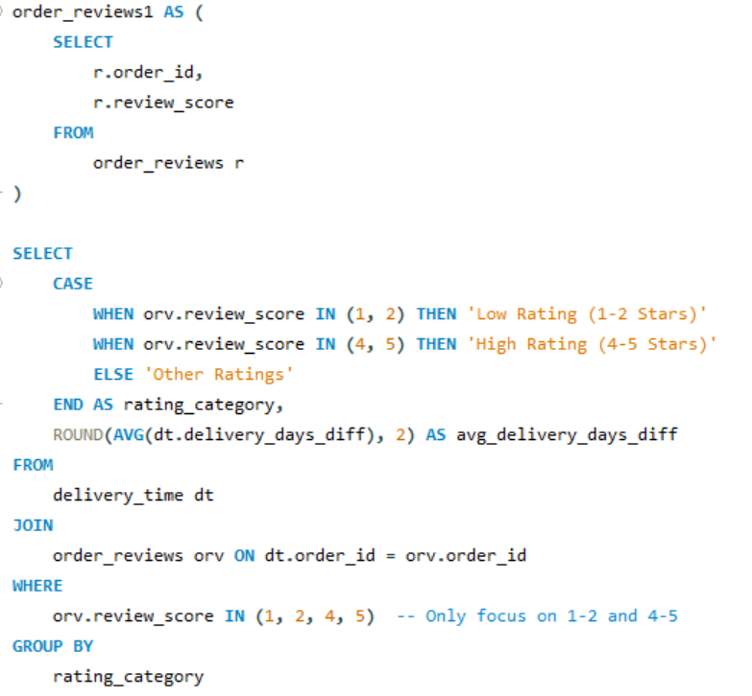
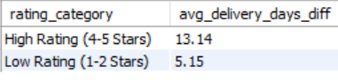
Review Sentiment vs Delivery Time: Compare average delivery days for orders with 1–2 stars vs 4–5 stars.

Slide 10
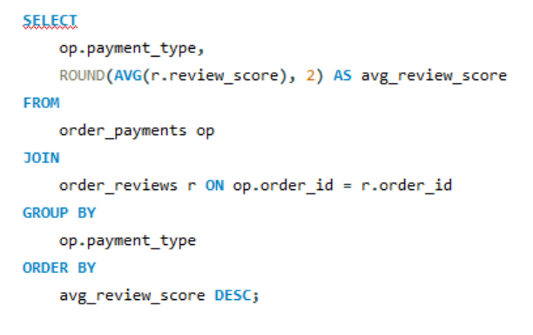
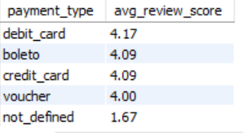
Payment Method Impact: Analyze which payment methods lead to the highest average review scores.

Slide 11
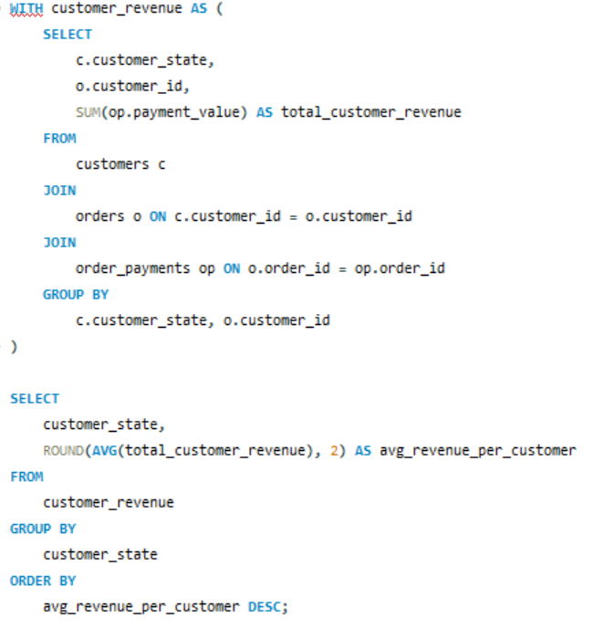
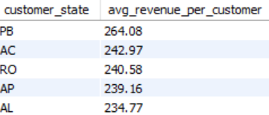
State-Wise Revenue Per Customer: For each state, compute average revenue per customer.

Slide 12
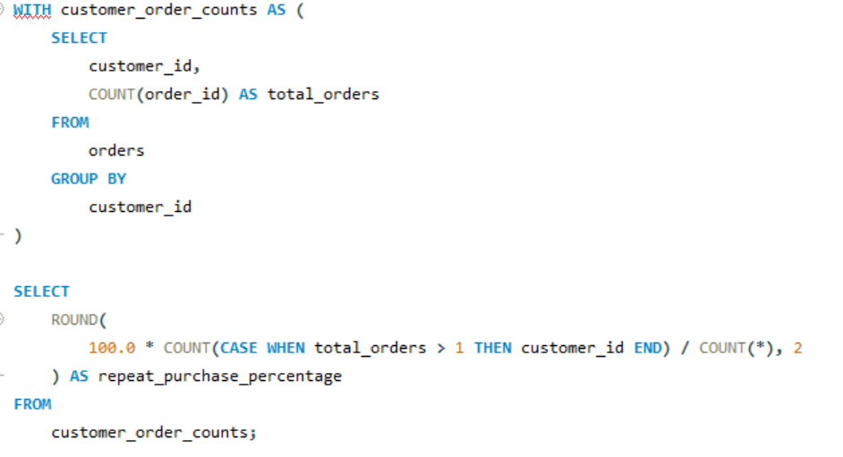
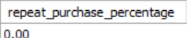
Repeat Purchase Analysis: What percentage of customers placed more than one order?

Slide 13
Power BI
Problems
Page 1: Executive Sales Overview
Total Revenue
Total Number of Orders
Average Order Value
Monthly Revenue Trend
Revenue Growth Rate (MoM)
Number of Active Customers
Repeat Customer Rate
Number of Sellers
kpi &Metrics
Key Metrics
Revenue: $13.59M
Active Users: 96K
Repeat Customers: 12.56%
Sellers: 3K
Low-Rated Orders: 15K
Avg. Rating: 4.02
Kpi & Metrics
Trends
Highest Revenue: May ($1.5M)
Lowest Revenue: Sep ($0.6M)
Top Growth: Jan (+44%), Nov (+42%)
Drop: Sep (–50%), Dec (–26%)

Slide 14
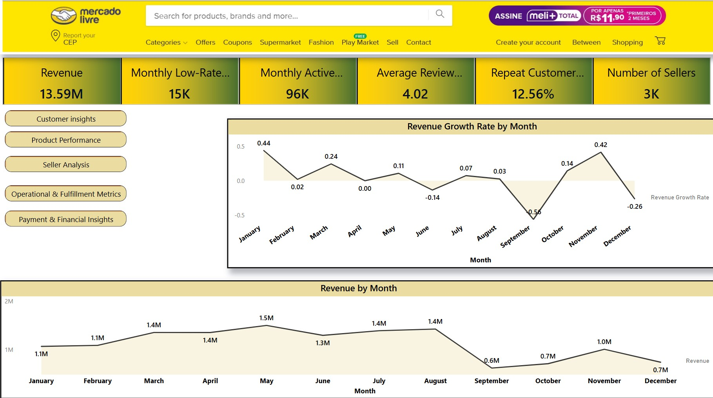

Slide 15
Problems
Page 2: Customer Insights
Total Customers
New vs Returning Customers (monthly)
Average Orders per Customer
Customer Retention Rate
Top States by Number of Customers
Average Review Score by State
Heatmap of Customer Locations (using geolocation)
Time to First Purchase
Kpi & metrics
Kpi & metrics
Customer Overview
Total Customers: 99K
Active This Month: 96K
Repeat Customer Rate (Sept): 33.33%
Avg. Orders per Customer: 1.00
Avg. Review Score: 4.02
Customer Distribution
Top State: SP (42K customers)
Next Highest: RJ (13K), MG (12K)
Global Reach: High concentration in Brazil, visible across South America, parts of Europe and Africa

Slide 16
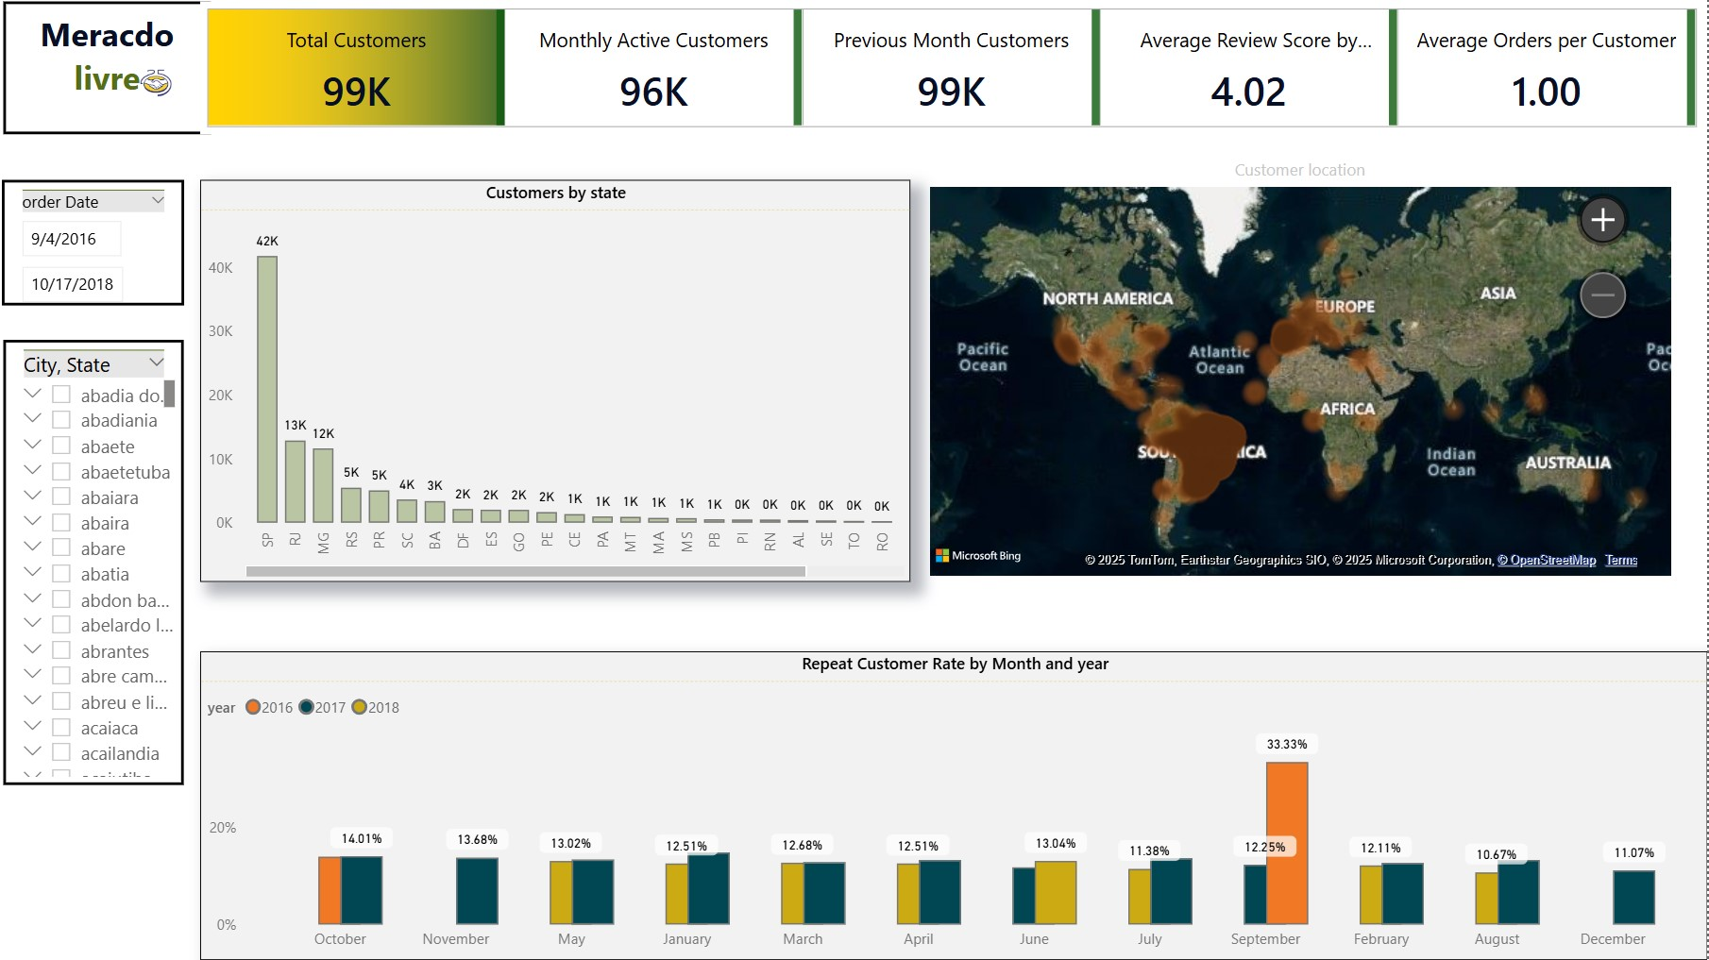

Slide 17
Problems
Kpi & Metrics
Page 3: Product Performance
Top 10 Product Categories by Revenue
Category-wise Average Order Value
Order Volume by Product Category
% Share of Each Category
Top 10 SKUs by Sales Volume
Bottom 10 SKUs by Review Score
Review Score Distribution by Category
Monthly Product Returns (low-rated products)
Sales & Reviews Overview
Total Orders: 99K
Avg. Orders per Category: 137.75
Low-Rated Monthly Returns: 15K
Top Reviewed Category: portateis_casa (4.29 stars)
Lowest Reviewed: seguros_e_servicos (2.50 stars)
Revenue Highlights
Top State by Revenue: SP – ₹5.2M
Top Category by Revenue: relogios_presentes – ₹1.21M
Top Product by Sales Volume: SKU aca2a7d00e... – 527 units

Slide 18
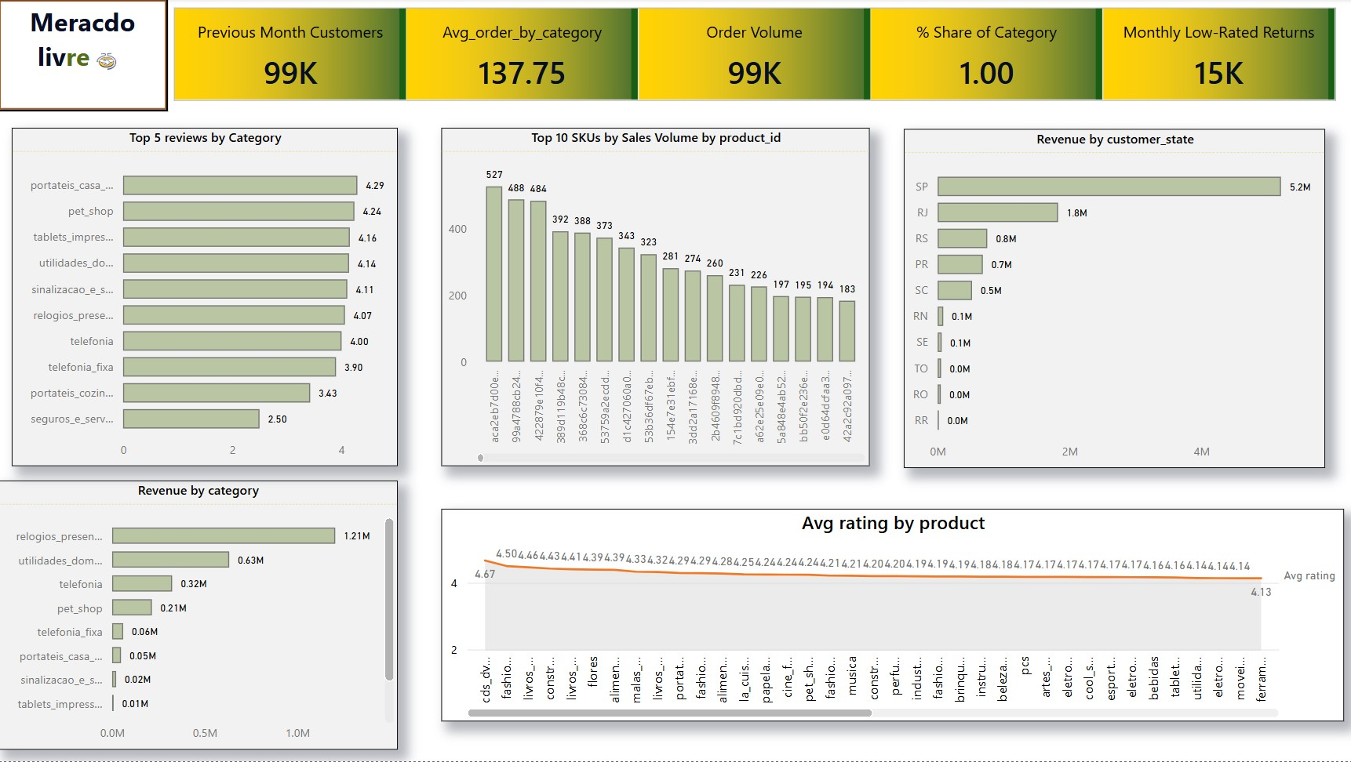

Slide 19
Problems
Seller Analytics
Top 10 Sellers by Revenue
Order Count per Seller
Average Delivery Time per Seller
Seller Efficiency Score (Delivery vs Estimation)
Seller-wise Return Rate
Geographical Spread of Sellers
Revenue per Seller by Product Category
Kpi & Metrics
April Performance Snapshot – Mercado Livre
Seller-wise Return Rate: 0.67%
Average Delivery Time: 12 days
Top Payment Method: Credit Card (76.32%)
Geographic Spread
Sellers are distributed globally, including regions like:
Brazil (Bahia, Santa Catarina, Afonso Claudio, etc.)
International locations: California, Colombo, Africa, etc.

Slide 20
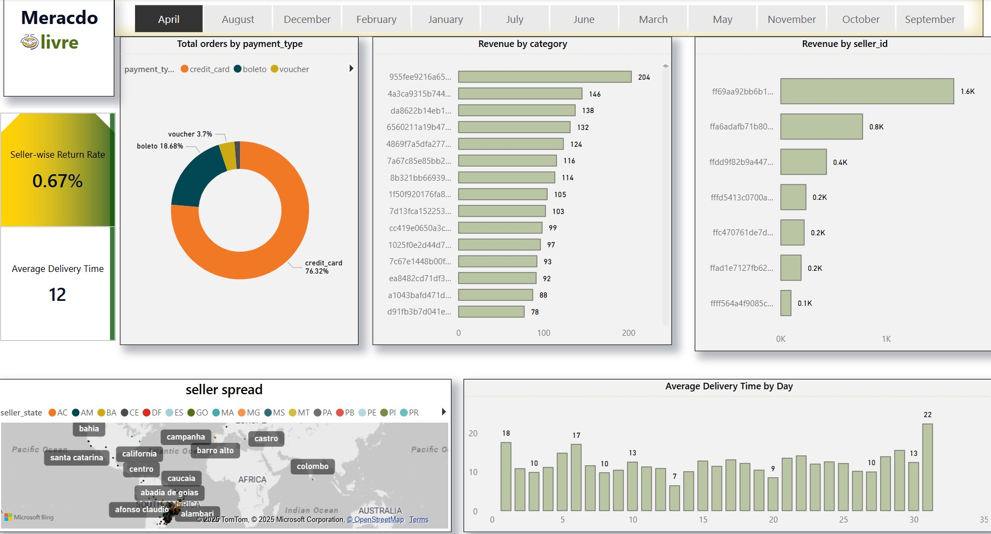

Slide 21
Problems
Operational & Fulfillment Metrics
Average Delivery Time
On-time Delivery %
Freight Cost per Order
Average Freight Cost per Category
Cancelled vs Completed Orders
Most Delayed Orders (Top 10)
State-wise Avg. Shipping Duration
Kpi & metrics
Delivery & Order Performance
Average Delivery Time: 12 days
On-time Delivery Rate: 93%
Freight Cost per Order: ₹13.69
Delivery Time by State
Slowest Deliveries:
Acre (AC): 21.45 days
Amazonas (AM): 21.07 days
Roraima (RR): 19.84 days
Fastest Deliveries:
Alagoas (AL): 8.22 days
Sergipe (SE): 9.98 days
Espírito Santo (ES): 10.85 days

Slide 22
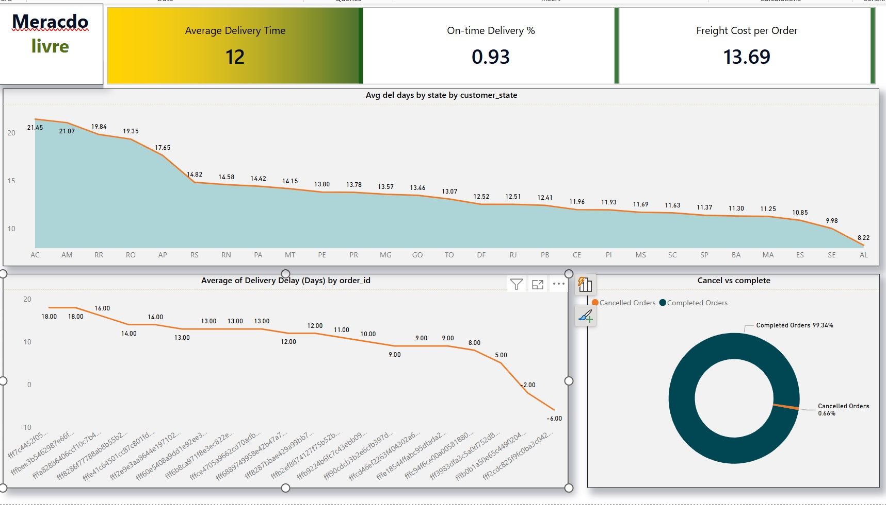

Slide 23
Problems
Kpi & Metrics
Payment & Financial Insights
Payment Methods Distribution
Avg. Payment Value per Method
Revenue by Payment Method
Refund/Failure Rate (if possible)
Month-on-Month Change in Transaction Volume
High-Value Orders Breakdown
Payment Metrics Summary
Average Payment Value per Method: ₹4.09M
Refund/Failure Rate: 0.40%
Sharpest Declines:
September: −59.27%
December: −33.12%
June: −13.17%
Top Growth Months:
January: +54.59%
November: +48.36%
October: +24.68%

Slide 24
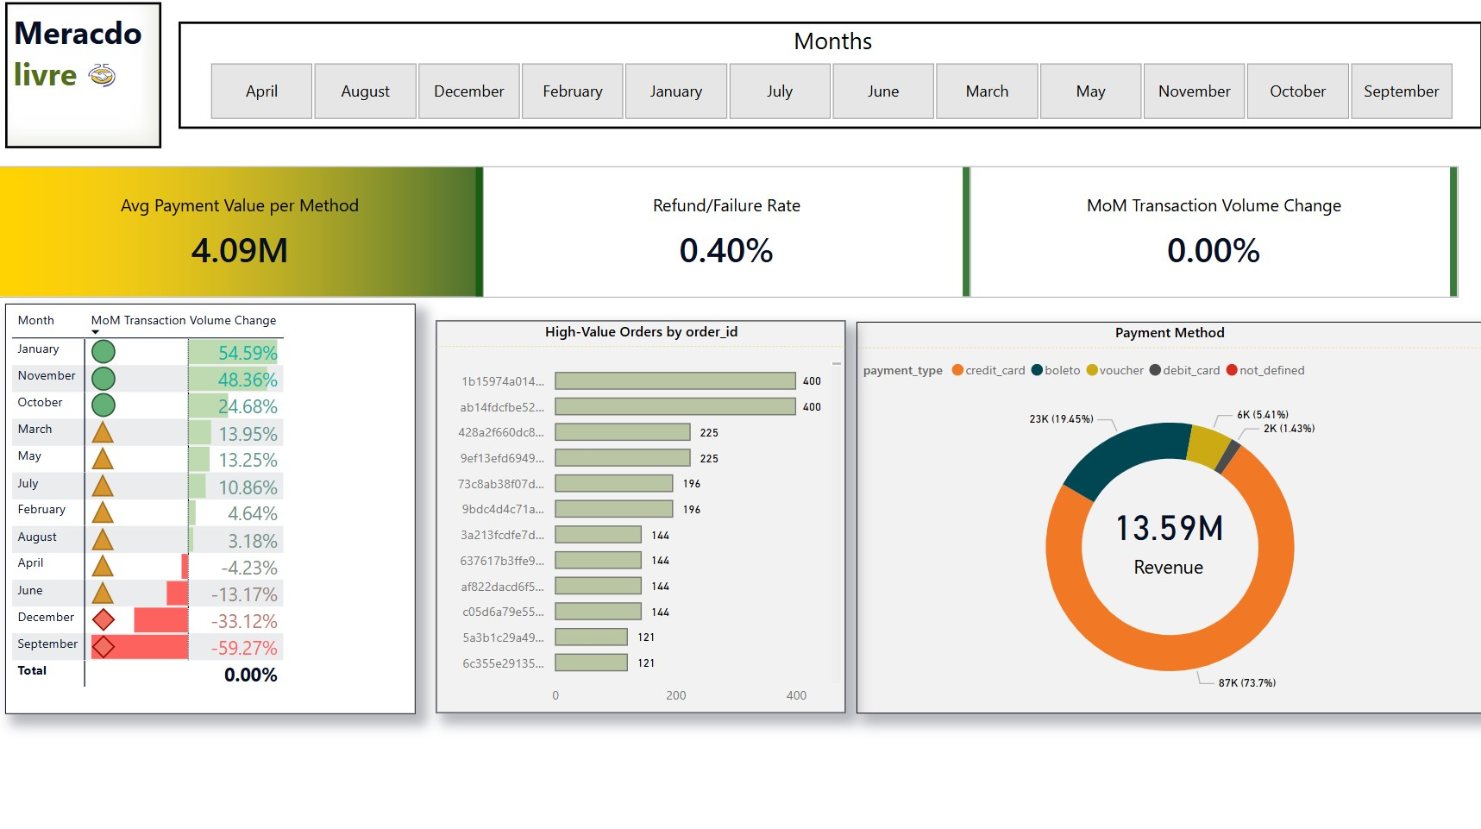

Slide 25
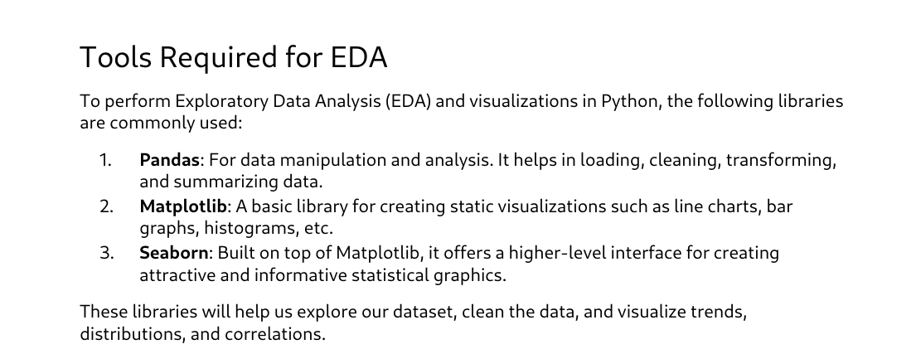
Python – EDA + Forecasting & Trend Analysis

Slide 26
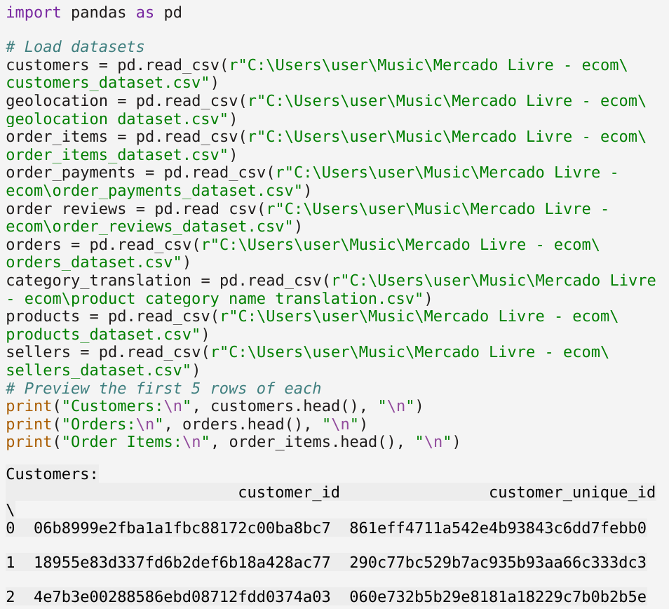

Slide 27
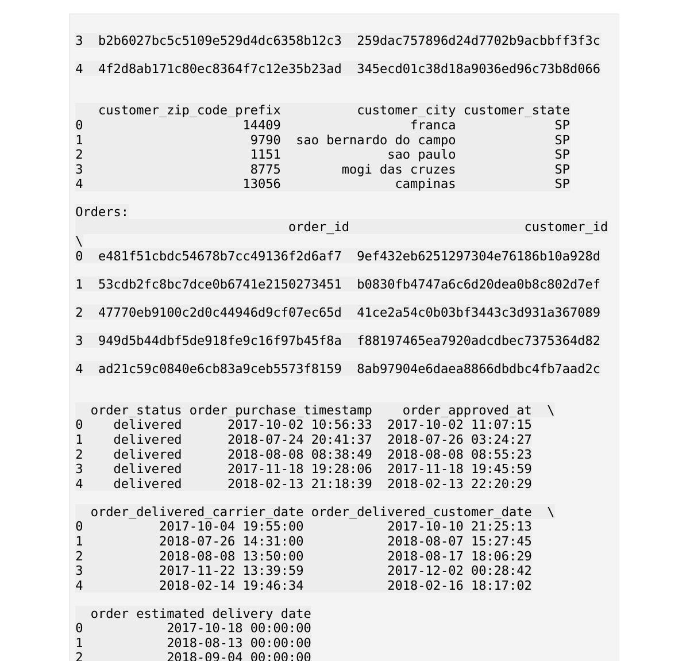

Slide 28
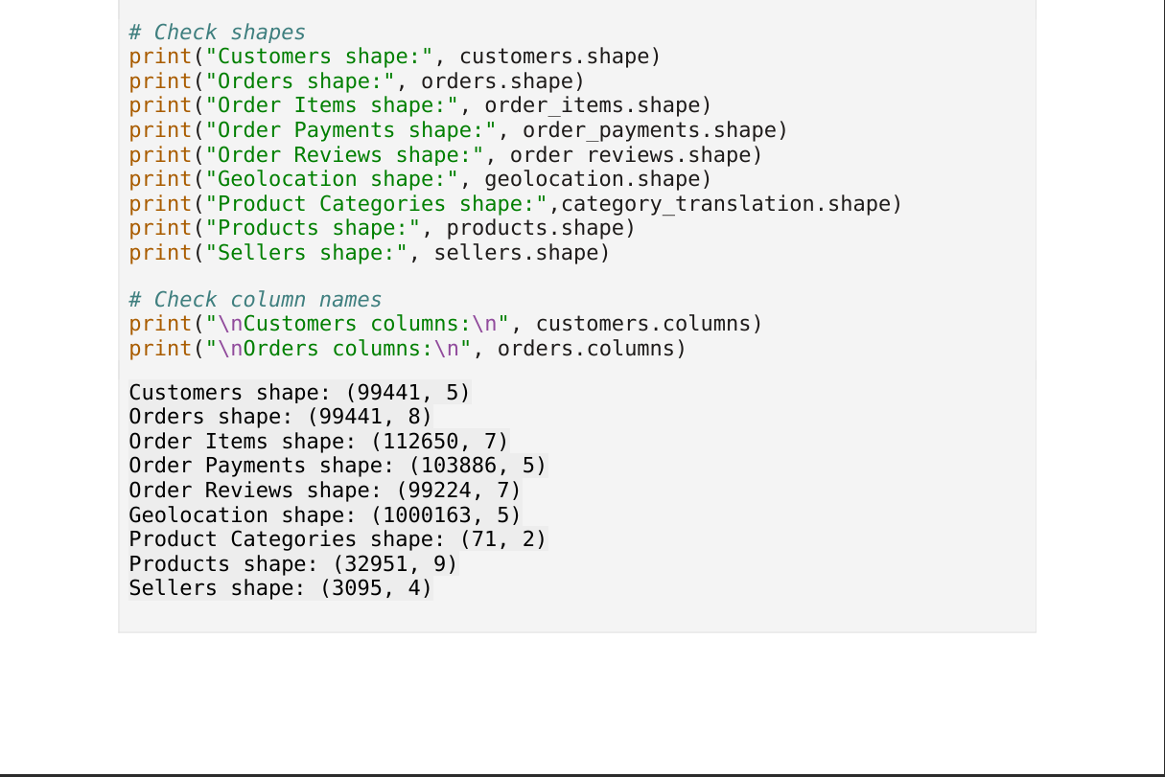

Slide 29
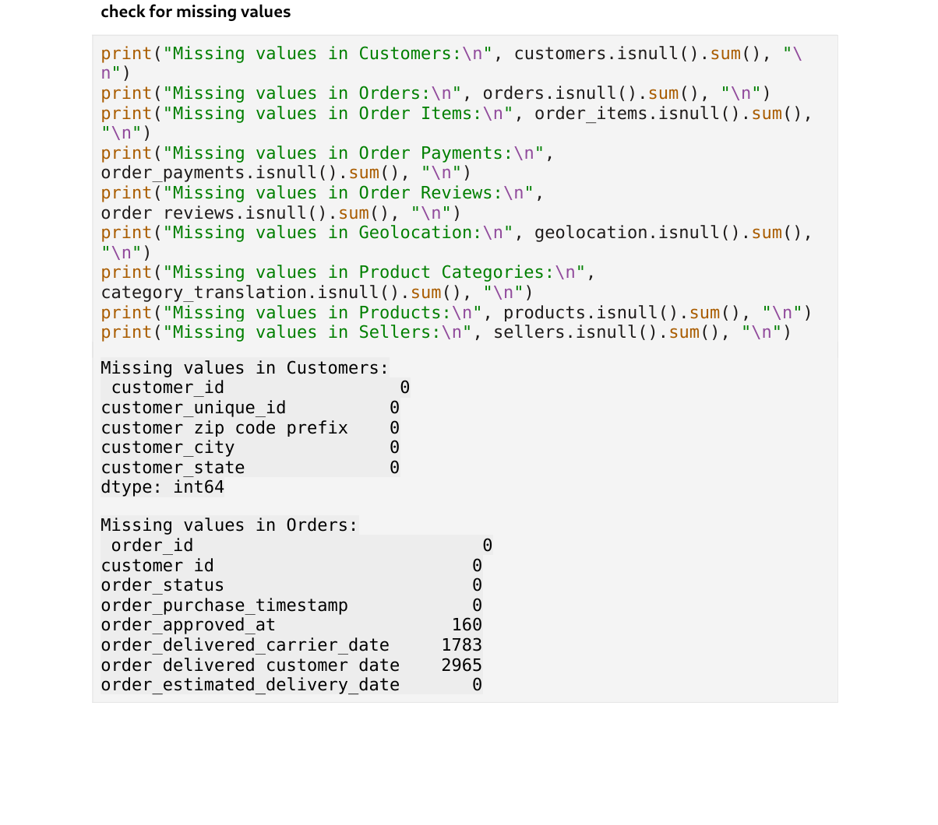

Slide 30
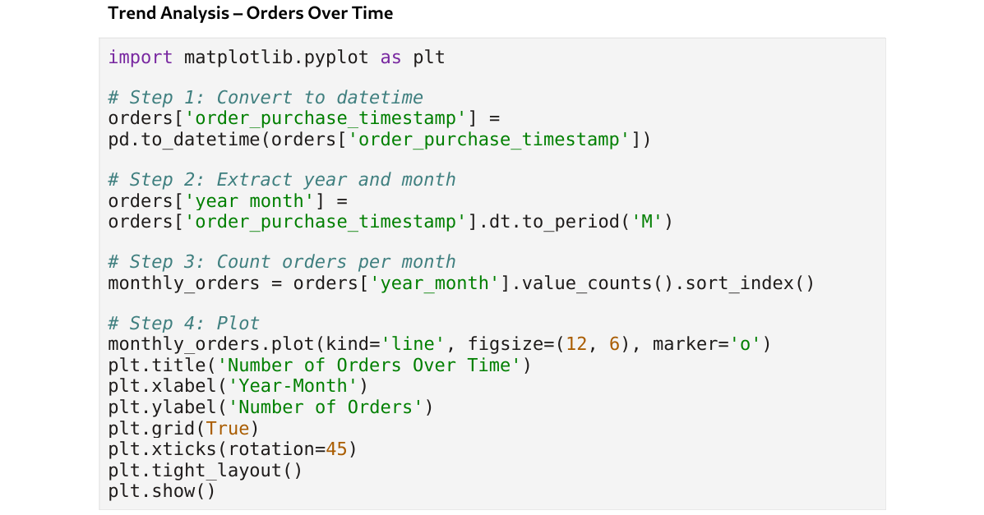

Slide 31
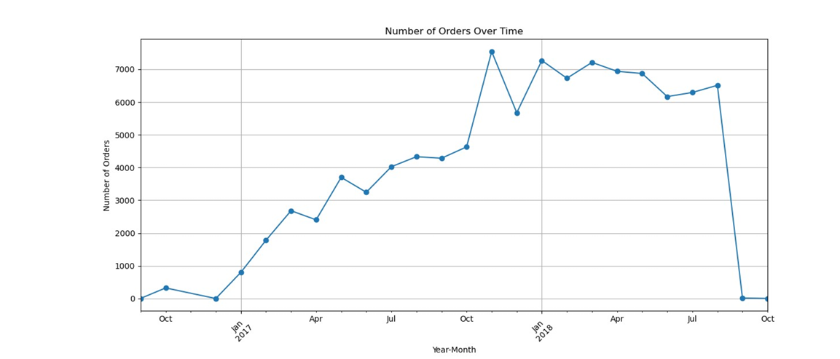

Slide 32
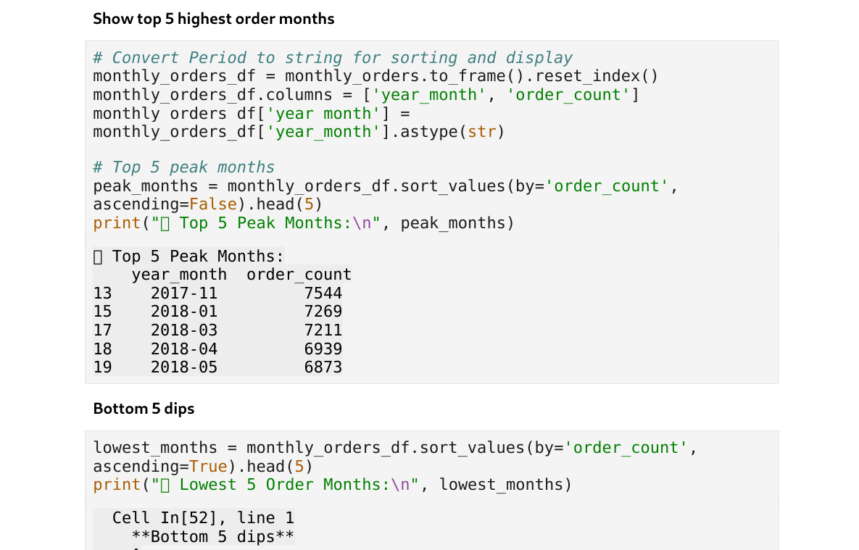

Slide 33
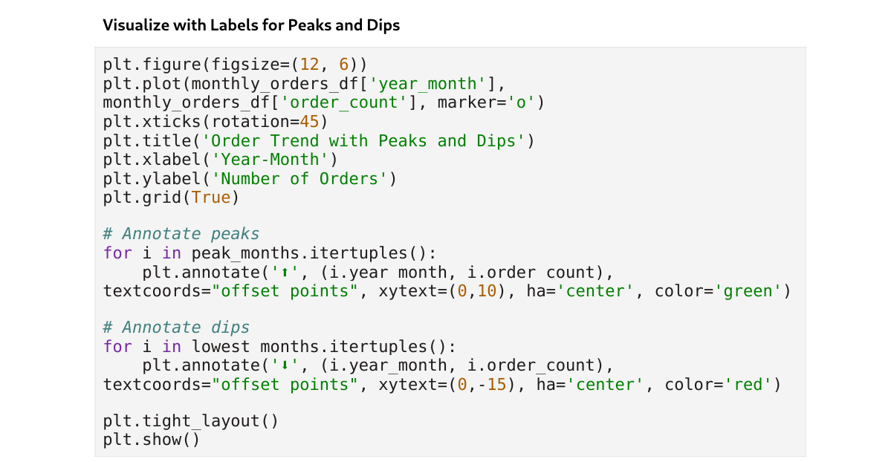

Slide 34
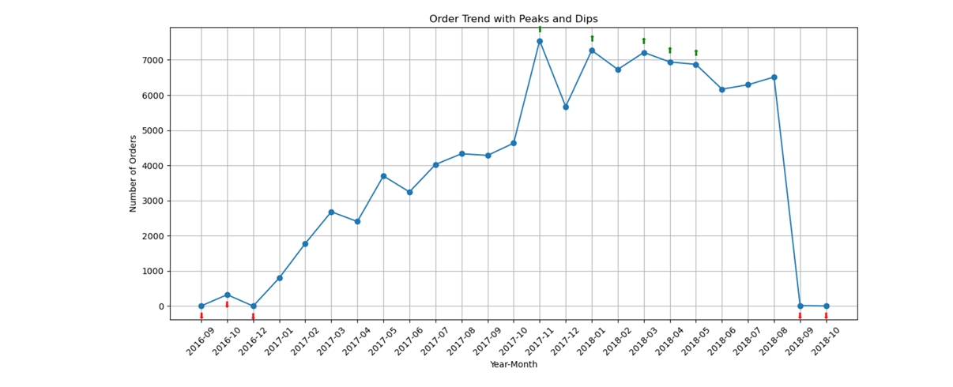

Slide 35
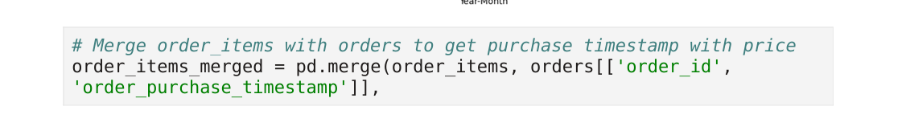
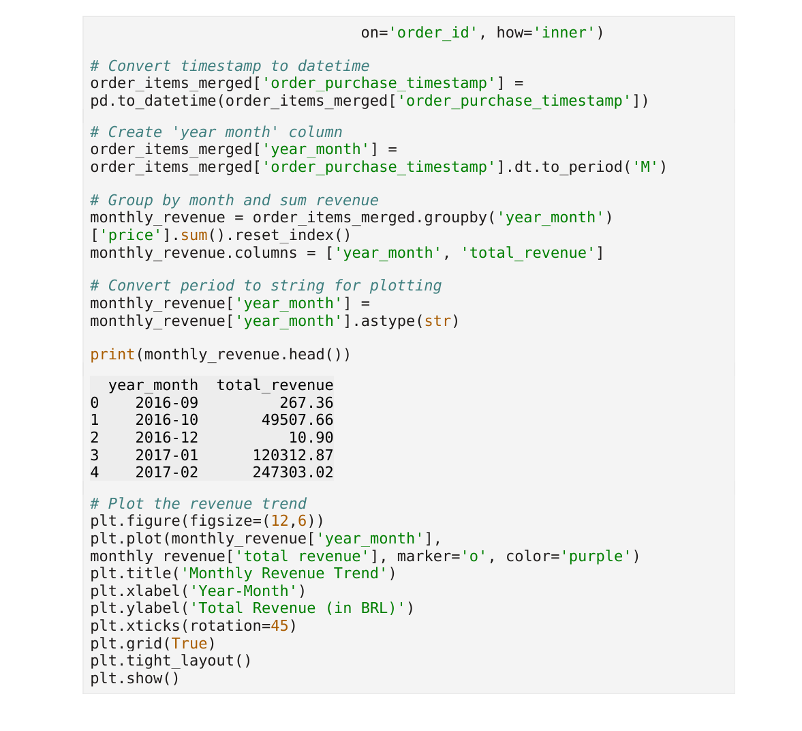

Slide 36
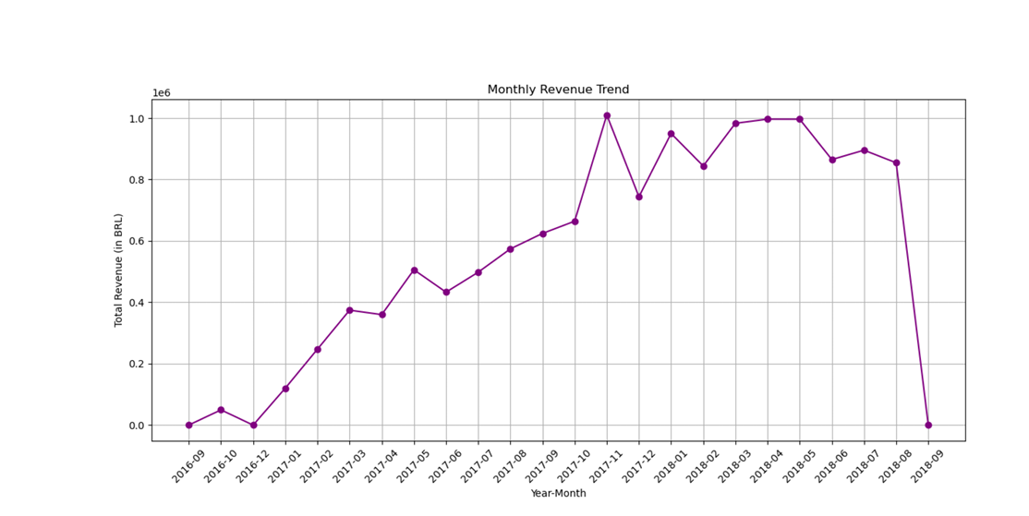

Slide 37
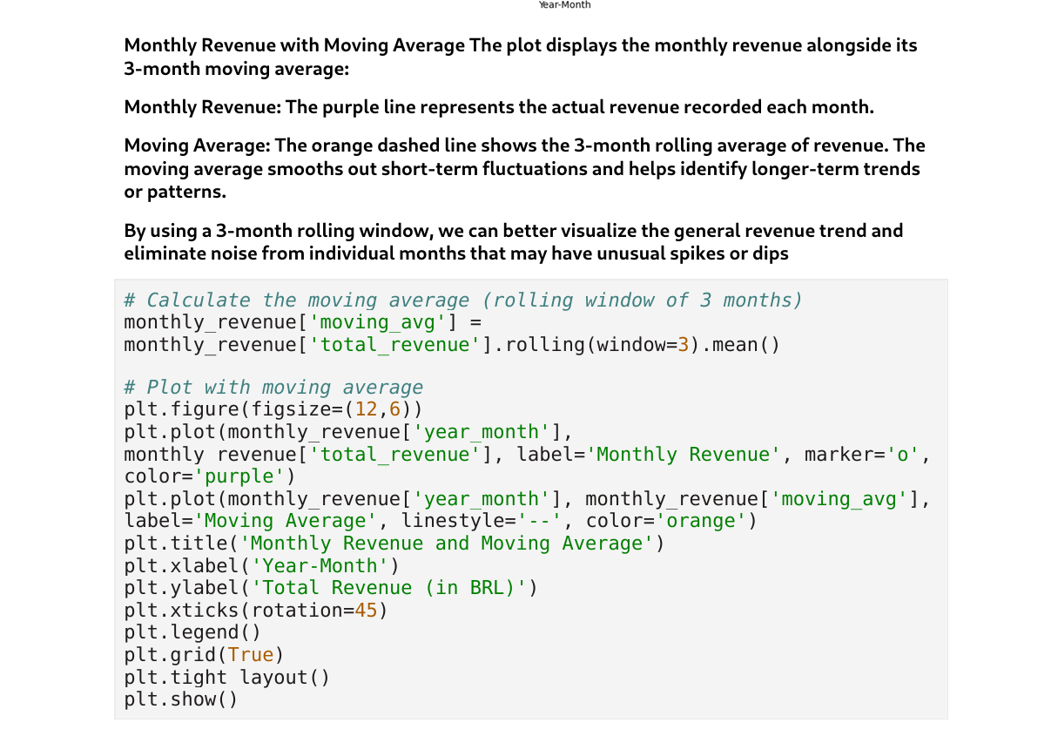

Slide 38
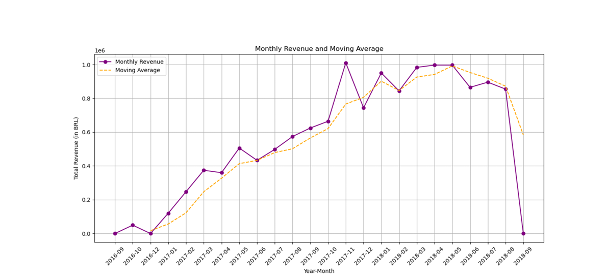

Slide 39
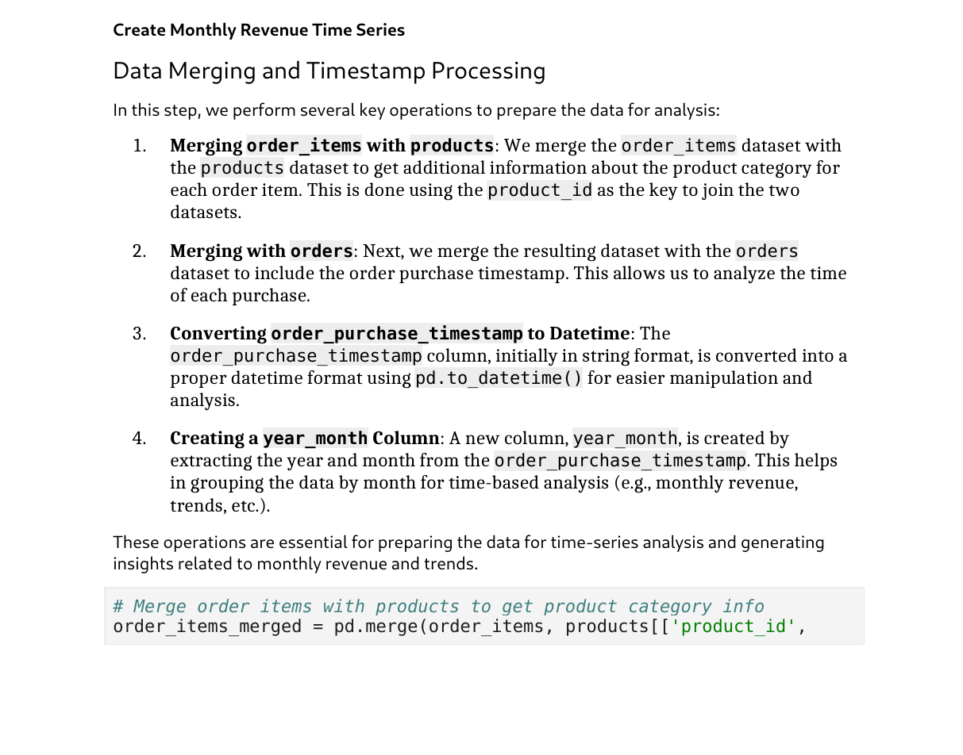

Slide 40
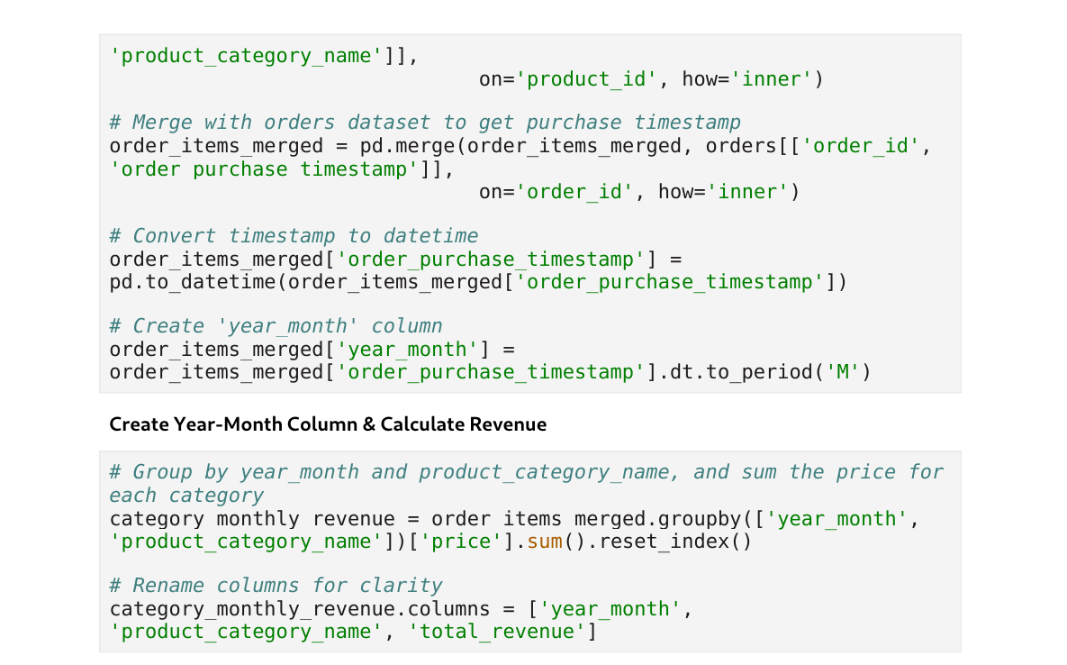

Slide 41
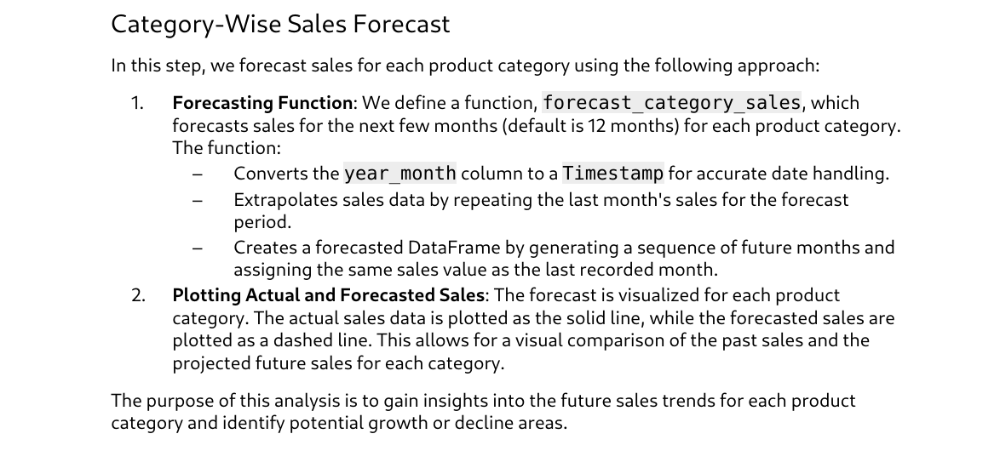
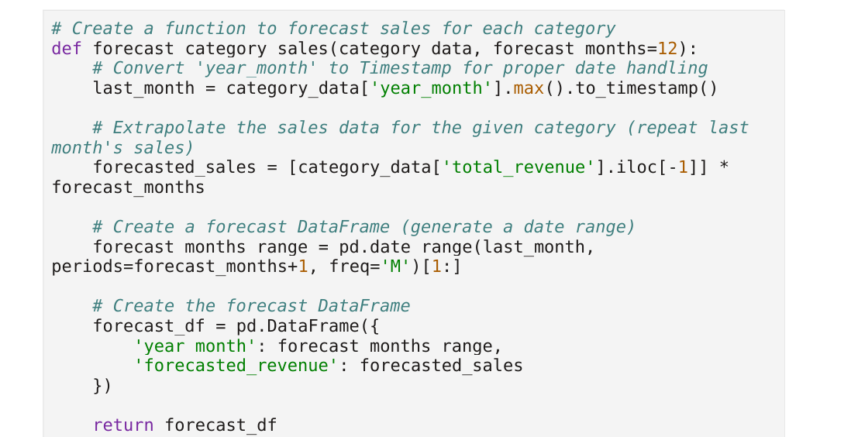

Slide 42
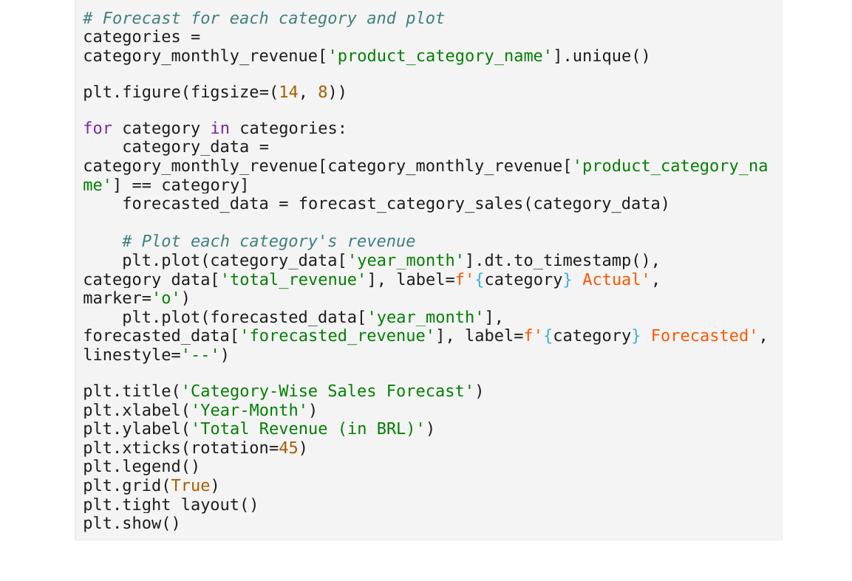

Slide 43


Slide 44


Slide 45


Slide 46


Slide 47


Slide 48


